Slide 1


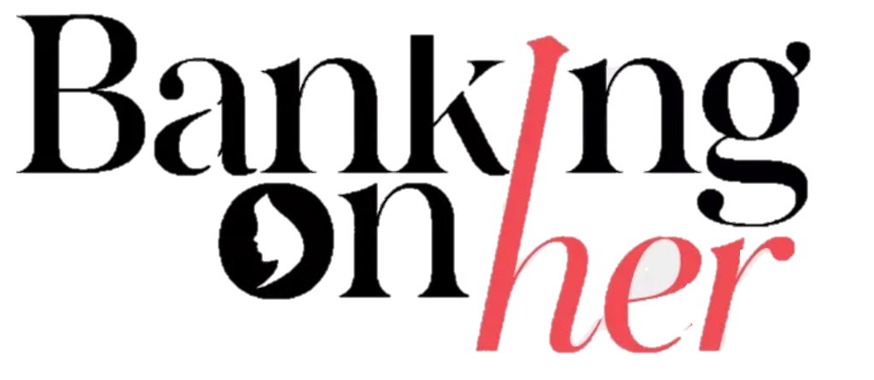
Malabar Gold & Diamonds
Team: Stonewalls

Slide 2
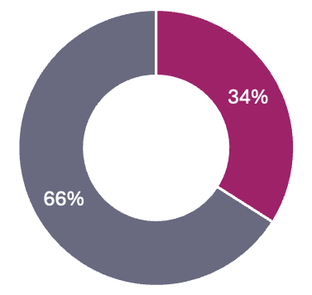
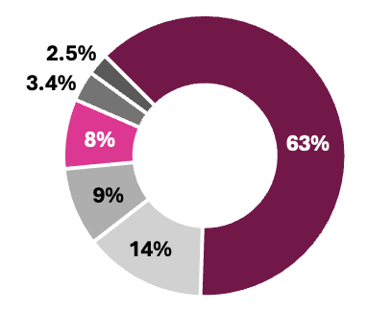
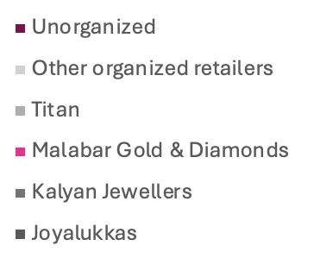



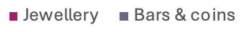


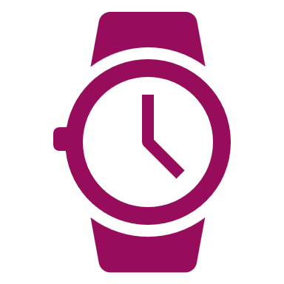




Gold & Jewellery Retail Industry Analysis
The gold and jewellery retail industry encompasses both traditional gold and non-gold segments, which include jewellery made from diamonds, silver, precious stones, platinum, and other materials.
Indian Market
27%
India’s share of global gold consumption
Gold Consumption
Market Share
Key Market Trends
Emergence of online jewellery market with an expected growth rate of 12% by FY28
Increasing preference for lightweight jewellery driven by working women and young population
BIS hallmark certification for quality assurance boosting consumer trust in the jewellery retailers
Gold as an investment option, with gold bars and coins comprising 34% of gold consumption in FY23
Buyback schemes and Monthly Investment Plans (MIPs) to promote consumer loyalty
Expansion of male jewellery market
Rising influence of social media in shaping fashion trends and visibility
US$ 70B
Market size (2023)
16% CAGR
Exp. growth (2023-2028)
Organized Retail Jewellers – Sourcing & Procurement Framework
Gold & Diamond Import
Gold & Diamond Procurement by Retailers
Hedging Strategy by Gold Retailers
Jewellery Procurement
Growth Drivers
Key Opportunities and Threats
1
Increasing disposable income leading to consumer spending on premium products
Expansion of retail stores into Tier II /III cities
Cultural and social significance of gold during weddings and festivals
India’s growing working age population
Global advantage through skilled artisans
Diversification into other jewellery types like pearls and lab grown diamonds
New business models to capture the growing demand for premium and personalized opportunities
Adoption to digital channels to expand into new markets
Regional and international expansion of existing brands
2
Opportunities
Porter Five Forces Analysis
3
Supplier Power: Medium
Product differentiation
Backward integration
Rivalry: Medium
Highly fragmented
4
Demand for gold/jewellery is price sensitive
Cash flow risks due to high inventory and seasonal sales
Impact of unanticipated regulatory shocks (e.g., import duty)
Buyer : Medium
Quality assurance
Low-cost switching
5
Threats
New Entrants: High
Opportunities in
fashion and
costume jewellery
6
Substitutes: High
Cheap alternatives (gifts)
Sources: Marketline, PNG DRHP, Screener.com, Private Circle – Joyalukkas
Notes:
This is a 70B $ market expected to grow at 16% CAGR.
While there is consistent demand from wedding and festival seasons, there are growth opportunities fueled by rising disposable incomes, middle-class aspirations, and the retail push into Tier II and III cities
The jewellery market is also transforming through the rise of online platforms, lightweight designs for modern consumers, BIS hallmarking creating new business models and opportunities for expansion.
It is worthwhile to note that this industry has high costs primarily driven by procurement– Gold and Diamonds and is subjected to unanticipated regulatory changes.
Having said that, this market is highly unorganized, with 63% dominated by informal players and Malabar holds an 8% market share. As the consumers are increasingly shifting away from family jewellers, there is a huge headroom for organized players like Malabar in this industry.

Slide 3




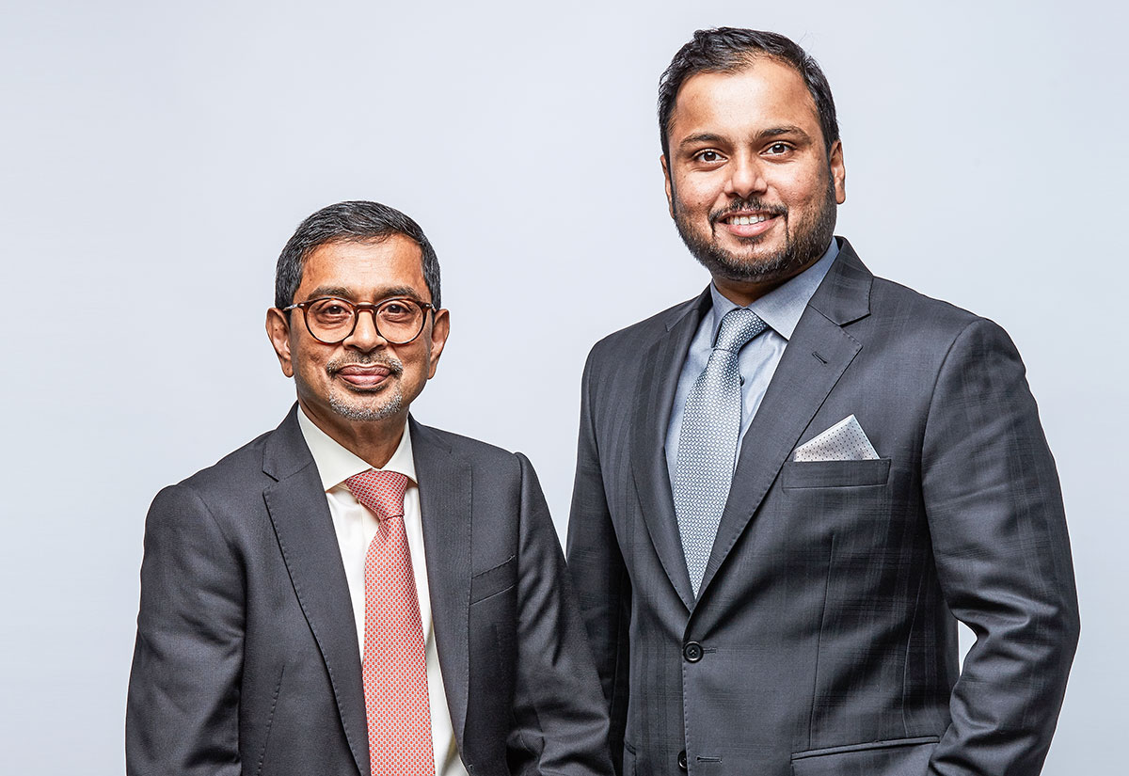








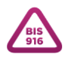



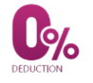

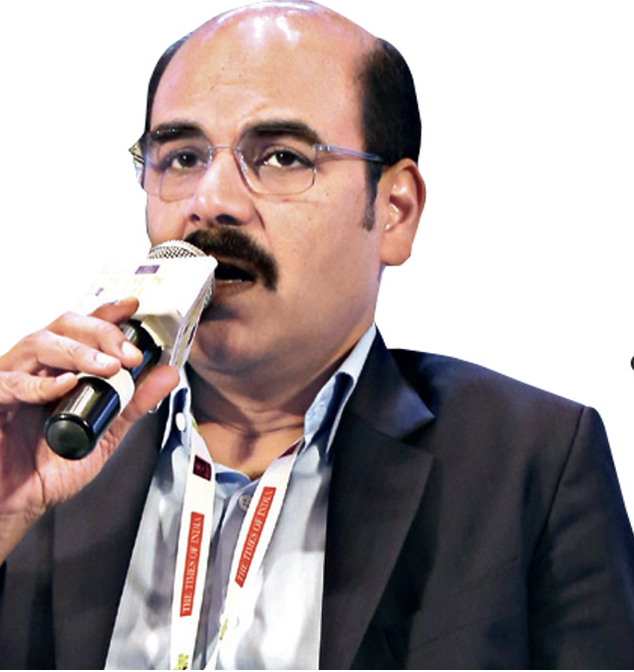



Malabar Gold & Diamonds
Manufactures, Sells & Trades in Gold, Diamond Studded & Silver Jewellery.
“
Our slogan is not just make-in-India but ‘ make-in-India and export to the World’. We are dutybound to the entire sector and our responsibility is not being just a gold smith.
Celebrate the beauty of life
”
*Malabar Gold Ltd. rebranded as Malabar Gold & Diamonds in 2012
- Asher Ottamoochikkal Managing Director, India Operations
1993, Kerala Established
360+
Outlets
21,000+
Employees
13
Countries
4,000
Partners
INR47,440+ Cr
Revenue (FY23-24)
19th Globally
Top 100 Luxury Goods Makers
6Th Globally
Largest Jeweller
14
Manufacturing units
Key Investors and Directors
Business & Operating Model
Key Strengths & Competitive Advantages
Ahammed M P
Founder, Director & Chairman,
Malabar Group
Source: Personal website
Manufacture, sale & trade Gold, Diamond and Silver Jewellery
Partnership with local businessmen
Robust Retail Division Margins
Revenue CAGR of 31% over FY21-24 to INR473 bn, driven by strong same-store sales growth, 25% p.a.
Giving them shareholding to set up and operate new outlets, while operating the day-to-day affairs of the business with a tight grip on the quality
Shamlal M P
Investor & Managing Director,
International Operations,
Malabar Gold & Diamonds
Source: Twitter
Ownership to employees to build an empire on trust, teamwork and goodwill.
Operational Synergies due to In-house Manufacturing
28MT gold and 21,000 carat diamond manufacturing unit capacity with 14 units in India and GCC
Source: CEO ME
Source: Forbes
Abdul Salam K P
Investor, Director & Vice-Chairman Malabar Group
Source: Facebook
Customer First Promise
Continued Geographical Diversification
Spread across 19 states in India & 141 showrooms in 13 countries, along with the innovative business model, it plans to open 100 new stores in FY 24-25.
Lifetime Maintenance
Jewellery Insurance
14 Day Return Policy
Certified Diamonds
Complete Transparency
BIS 916 Hallmarked
Guaranteed Buyback
Easy exchange
Nishad A K
Co-founder, Malabar Group
Group Executive Director,
Malabar Gold & Diamonds
Chairman at Cosmos Sports
Source: LinkedIn
Challenges & Risk Factors
Zero deduction Gold exchange
Source: Website
Complex Group Structure
44 companies in the group for the retail jewellery business, with significant inter-group transactions.
Future Expansion Plans
Asher Ottamoochikkal
Managing Director, India Operations,
Malabar Gold & Diamonds
Overall Margins Low
EBITDA margins at 2.9% in FY24 due to high promotional
& software expenses, rise in pre-operative expenses for new stores. Profit margins optically lower than industry peers.
Year 2026
Targeting for public listing
100-200
New Stores (FY 24-25)
INR 60,000+ Cr
Target Revenue
(FY 25-26)
New Indian Markets: Jharkhand, Goa, Assam, and Tripura
International Markets: South Africa, Egypt, Bangladesh, Turkey, New Zealand
Intense Competition
Competition from large organised and unorganised local jewellers, along with stagnant industry volume growth and aggressive expansion.
Mayankutty C
Investor & Director, Malabar Group
Veerankutty P
Investor & Director,
Malabar Group
Sources: Private Circle ZaubaCorp MGT-7 List of shareholders
Source: CNBC-TV18
Source: IndiaRatings
Notes:
MGD – Malabar Gold and Diamonds. Established in 1993 as a small family-run business, Malabar has rapidly expanded over the past three decades to become the 6th largest jeweller globally, with over 360 outlets today.
A closer look at its investor structure reveals that most key investors come from the close circle of its founder, Mr. Ahammed, reinforcing a strong foundation of trust and stability.
The business operates through a mix of direct and franchisee run structures, supported by a centralized gold manufacturing and investment framework. These outlets often involve significant intergroup transactions, which, while offers greater flexibility to the store owners, also poses challenges related to transparency.
Malabar’s franchise model is built on strategic partnerships with local businessmen through a 15% profit-sharing agreement. Many stores are managed by individuals from the inner circle, who are granted part ownership to build trust. Also, ownership opportunities are extended to employees, enhancing commitment and driving the high retention rates
The group is currently following an organic growth strategy aiming to open 100 – 200 new stores in this financial year, solidifying its position as a global leader

Slide 4



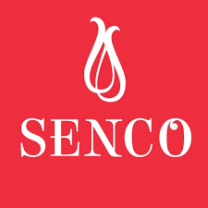
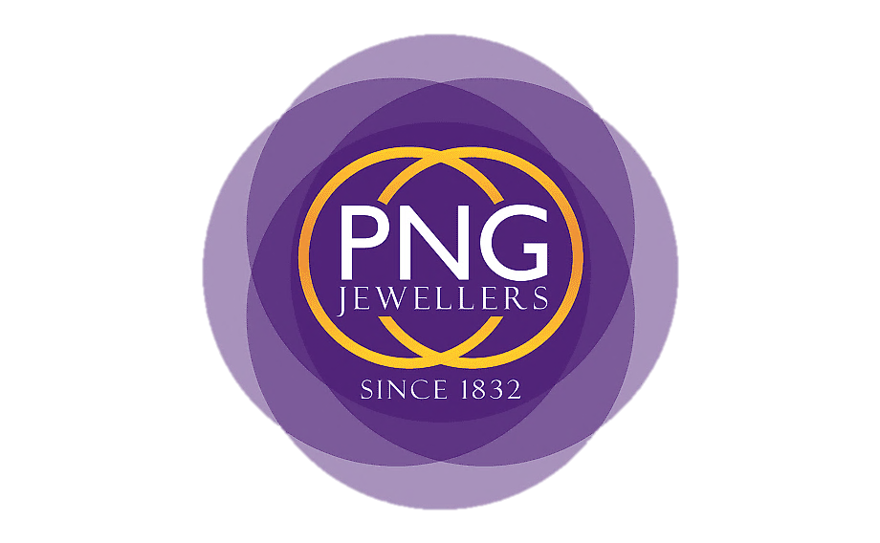





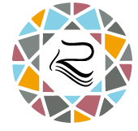

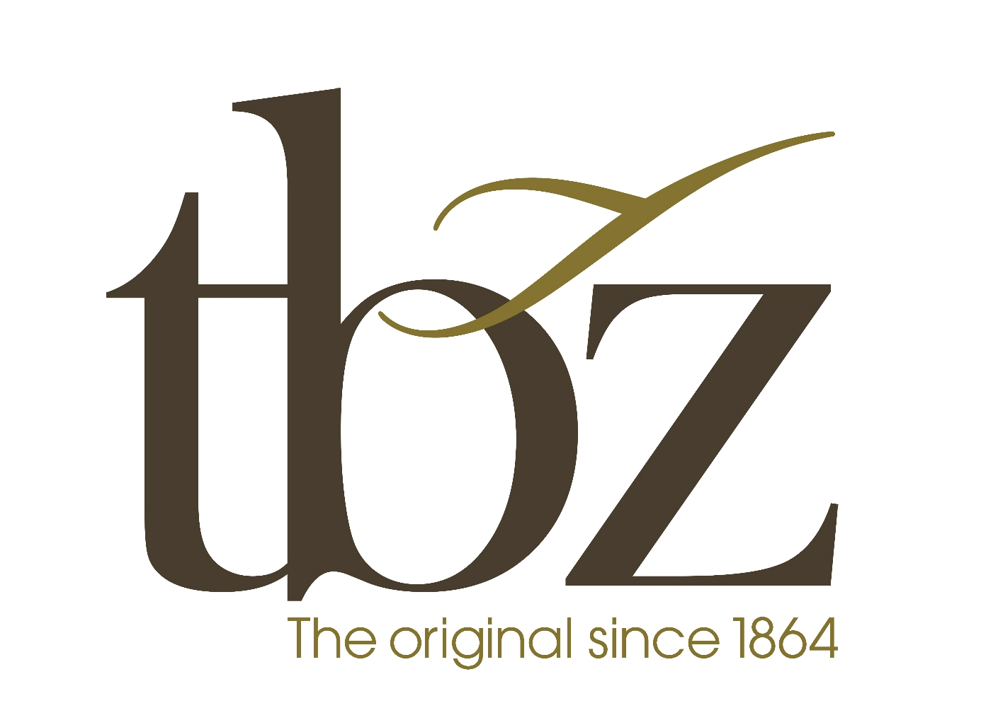
Peer Benchmarking
Comprehensive analysis of the company’s geographical footprint, revenue models, financial health, and value chain integration, offering insights into its market positioning, operational efficiency, and strategic priorities.
All figures are in INR Cr
Parameters | Malabar Gold & Diamonds | Titan Company* | Kalyan Jewellers | Senco Gold | P N Gadgil Jewellers | Rajesh Exports | PC Jewellers | Thangamayil | Joyalukkas** | Sky Gold | T B Z | Radhika Jeweltec | Asian Star Co.
Parameter
Key Insights (Malabar Gold & Diamonds Vs Peers)
Malabar is among the top revenue generators, indicating robust market demand
Sales (Cr)
40k-50k | 50k-60k | 10k-20k | 1k-10k | 1k-10k | >60k | <1k | 1k-10k | 10k-20k | 1k-10k | 1k-10k | <1k | 1k-10k
D/E
0.93 | 1.65 | 1.07 | 1.28 | 0.66 | 1.17 | 0.04 | 1.08 | 0.50 | 1.3 | 1.02 | 0.19 | 0.49
Lower debt(0.93) compared to major competitors reflects good financial health and growth flexibility
Stores (South India)
67% | 37% | 55% | 2% | 0% | 100% | 0% | 100% | 66% | 80% | 3% | 0% | 0%
Strong regional expertise and brand recognition in South India, competing with Kalyan & Joyalukkas
Stores (India)
205 | 750 | 209 | 145 | 27 | 82 | 79 | 59 | 105 | 10 | 34 | 2 | 0
Broad national footprint, behind Titan (750) indicating extensive operational scale and strong reach
International Stores
145 | 25 | 30 | 1 | 1 | 0 | 0 | 0 | 55 | 0 | 0 | 0 | 0
Market leader internationally, far ahead of Joyalukkas (55), capturing global demand effectively
Revenue streams
B2C Offline + E-comm | B2C Offline + E-comm | B2C Offline + E-comm | B2C Offline + E-comm | B2C Offline + E-comm | B2C Offline + E-comm | B2C Offline + E-comm | B2C Offline + E-comm | B2C Offline + E-comm | Majorly B2B | B2C Offline + E-comm | B2C Offline | B2B
Matches Titan and Kalyan’s omnichannel strategy, ensuring adaptability to evolving consumer trends
Integration
Retail + Manufacture | Retail + Manufacture | Retail + Manufacture | Retail + Manufacture | Retail | Majority Manufacture | Retail + Manufacture | Retail + Manufacture | Retail + Manufacture | Majority Manufacture | Retail + Manufacture | Retail + Manufacture | Manufacture
Vertical integration is similar to companies like Kalyan and Titan, ensuring cost efficiency and value control
Key competitors
These competitors closely align with Malabar’s business model, positioning, and strategies across revenue, footprint, and operations.
Key Competitors
(Focus Group)
* Titan Company includes various segments such as watches, jewellery, Indian wear, fragrance and fashion accessories, however, as financial and operational metrics specific to jewellery segment are not publicly available, metrics for the Titan Company as a whole have been considered.
** Estimates for FY2022-23 have been used as estimates for FY2023-24 were not available
Sources: Screener.com Private Circle - Joyalukkas
Company website and annual reports
Notes:
These are the leading players in the Gold & Jewellery Retail market. We will further narrow these down based on these parameters like Sales. These parameters are chosen to understand the size, geographical footprint and revenue models of the firms.
We have highlighted the values that are comparable to Malabar for this parameter.
The companies similar to MGD in size are higlighted and so on and so forth for each parameter.
D/E tells us about the stage of financing.
To gauge the distribution of presence, we have counted South Indian, PAN Indian and –international presence.
Vertical Integration
Based on how close these companies resemble MGD, we have chosen the focused core group

Slide 5

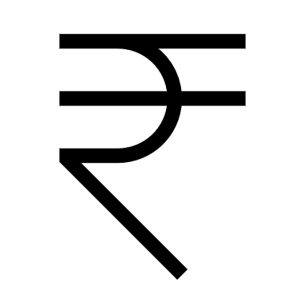


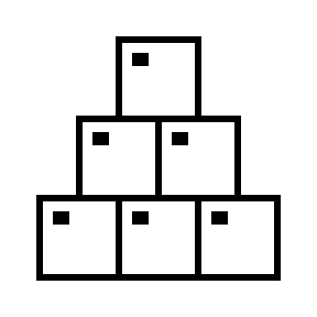
Key Metrics
Insights -
Malabar Gold & Diamonds
Risks to consider
Parameters | Malabar Gold & Diamonds | Titan Company | Kalyan Jewellers | Senco Gold | Thangamayil | Joyalukkas** | T B Z
Severe Risks
Not identified
Strengths
Financial
P/E |  | 87 | 118 | 50 | 55 | 18.2 | 33
Revenue from Operations | 47,448 | 52,453 | 19,708 | 5,340 | 4,094 | 14,526 | 2,324
EBITDA | 1,307 | 5,334 | 1,164 | 405 | 198 | 1,529.65 | 130
EBITDA Margin | 2.7% | 10.2% | 5.9% | 7.6% | 4.6% | 10.5% | 5.6%
D/E | 0.93 | 1.65 | 1.07 | 1.28 | 1.08 | 0.5 | 1.02
PAT Margin | 0.02 | 0.07 | 0.03 | 0.04 | 0.03 | 0.06 | 0.03
ROE | 19.00% | 32.91% | 15.22% | 16.32% | 27.95% | 31.35% | 9.33%
ROCE | 22.00% | 22.70% | 14.04% | 13.82% | 20.29% | 35.60% | 10.88%
Current Ratio | 1.29 | 1.45 | 1.31 | 1.56 | 1.54 | 1.90 | 1.66
Strong revenue performance with high efficiency per store, indicating a focused and high-performing store model
Exceptional inventory turnover of 29 days indicates efficient inventory management and good operational strength
Medium Risks
Low Cash Balance
47,448
Low Risks
Low inventory
Thin Margins
Income Projections based on key metrics FY 24-25
2.7%
0.93
405 Stores
139 Cr
/Store
56,241
Cr.
Weaknesses
MGD to add 100 stores by 2025 and revenue/store has been consistently growing @ 7.8% for last 3 years
19.00%
Low profit margins despite high revenue, indicates high operational costs or lower pricing power highlighting the need for cost control systems
Low liquidity (current ratio of 1.29) suggests potential short-term liquidity issues and financial inflexibility
REVENUE
22.00%
COSTS
Operational
Stores (Global) | 350 | 775 | 239 | 146 | 59 | 160 | 34
Revenue from Ops. per store | 136 | 68 | 82 | 36 | 69 | 91 | 68
Revenue from Ops. per sq. feet | 0.02 | 0.02 | 0.01 | 0.01 | 0.05 | 0.02 | 0.02
EBITDA per store | 2.76 | 6.88 | 4.87 | 2.77 | 3.37 | 9.56 | 3.84
PAT per store | 2.12 | 4.46 | 2.64 | 1.46 | 2.05 | 5.62 | 1.77
Days Inventory | 28.57 | 176.34 | 191.27 | 200.95 | 127.52 | 274.45 | 159.87
12,631 Cr
23,376 Cr
1,642 Cr
136
Cost Materials Consumed
Purchase of stock traded + Operating Expenses
EBITDA
Opportunities
This is observed to proportional w.r.t to revenue.
22-27% revenues.
This is highly driven by purchase of gold and diamond. Hence directly proportional to revenue
(40-45% of revenues)
Very thin margin of
2-5%
2.76
Malabar is effectively using its capital (ROCE of 22%), but the return to shareholders could be improved, possibly through better profit management
All figures are in INR Cr
** Estimates for FY2022-23 have been used as estimates for FY2023-24 were not available
Sources: Screener.com Moneycontrol Private Circle - Joyalukkas
Notes:
Let’s delve deeper into key financial and operational metrics.
Malabar, despite having highest revenue per store, suffers from lowest EBITDA margin. Reason? Lack of cost efficiency. Malabar owns only 27% of manufacturing and designing capabilities, leading to high making costs. However, The company plans to expand the same by 5-10% within next two years giving an upside EBITDA potential of 2-3% in long term.
Talking about the trends, although revenue and EBIDTA has grown around 20%, EBIDTA margins have taken a dip. ROE and ROCE are both around 20% indicating an effective capital allocation. ROE is lesser than ROCE which suggests upside potential for returns via debt allocations. Low Debt Equity ratios also confirm the same. Moreover, interest coverage ratios for Malabar has improved leading to an upgrade in its credit ratings, according to latest ratings, which calls for a cheaper cost of debt investments.
Other than this, we can see its strengths in efficient inventory management, however low liquidity suggests short term liquidity issues, which can also be seen as risk to the company, along with thin margins and low inventory.
Revenue per store has been consistently growing @ 7.8%. And we will be using it later in DCF valuation but now let's do a relative valuation.

Slide 6
Valuation
All figures are in INR Cr.
Relative Valuation – Focus group – Key Competitors
Relative Valuation – Industry peers
Discounted Cash Flow Valuation
 |  | Titan | Kalyan | Senco | Thanga. | T B Z | Joya Lukkas*
Market Data | Price (on 21 Oct '24) | 3,363 | 704 | 1356 | 2,318 | 297 | 109.40****
 | Market Cap. | 2,98,584 | 72,603 | 10,540 | 6,360 | 1,987 | 16,410***
 | EV | 3,12,586 | 76,115 | 11,749 | 6,810 | 2,551 | 16,903**
Financial Data | Sales | 52,453 | 19,708 | 5,340 | 4,094 | 2,324 | 14,526
 | EBITDA | 5,826 | 1,440 | 437 | 218 | 151 | 1,529
 | Earnings | 3,454 | 630 | 213 | 121 | 60 | 899
 | D/E | 1.65 | 1.07 | 1.28 | 1.08 | 1.02 | 0.5
Valuation | EV/Sales | 5.96 | 3.86 | 2.20 | 1.66 | 1.10 | 1.16
 | EV/EBITDA | 53.65 | 52.85 | 26.88 | 31.27 | 16.83 | 11.05
 | EV/EBIT | 58.60 | 65.38 | 29.00 | 34.29 | 19.55 | 12.08
 | P/E | 86.45 | 115.19 | 49.34 | 52.48 | 33.06 | 18.25
Peer company | EV/EBIDTA
MGD plans to open 100 stores in FY 24-25. Currently,
In 6 months, 20 stores have opened. We have assumed that 40 more stores would open in this year considering many are in progress. This takes the store count to 405 by the end of FY 2024-25.
Average | Median
2.66x | 1.93x
32.09x | 29.10x
36.48x | 31.65x
59.13x | 50.91x
 | Titan | 53.65
 | Kalyan | 52.85
 | Senco | 26.88
 | P N G | 35.82
 | Rajesh | 26.83
 | PC J | 73.88
 | Thanga. | 31.27
 | JoyaLukkas | 11.05
 | Sky Gold | 49.76
 | TBZ | 16.83
 | Radhika | 21.6
 | Asian Star | 12.31
Source: ET Retail
As we have seen, revenue/store for MGD has been growing @7.8% consistently with 2% premium over inflation.
Growth (Revenue/Store ) = 7.8%
Import duty on Gold has been reduced from 15% to 6%. Thus, COGS have been assumed to grow at the lowest of the historical rate
Source: Mint
There is no product differentiation.
*Beta = 1.1 | D/E is 0.93 | WACC = 11.29%
Source: Bloomberg Terminal
We have assumed FCFF to grow at 4% (conservatively) because of risk of saturation and lack of differentiation. The terminal value growth starts after 2 years, after which they plan to go public.
Source: CNBCTV18
Relative Valuation – Key competitors
Enterprise Value / EBITDA | 29.10
EBITDA | 1,307
Enterprise value | 38,034
* Estimates for FY2022-23 have been used as estimates for FY2023-24 were not available ** Fortune India article *** (EV - Total Debt + Cash) **** Market Cap. / (No. of equity shares as filed in MGT-7 for FY 2022-23)
Average | 34.39x
Median | 29.07x
DCF Valuation
Terminal value | 50,996
PV of terminal value (Gordan Growth) | 36,997
PV of forecast | 6015
Enterprise value | 43,013
* Complete DCF calculations are presented in the Appendix
Relative Valuation – Industry
Enterprise Value / EBITDA | 29.07
EBITDA | 1,307
Enterprise value | 37,994
Sources: Screener.com Moneycontrol
Private Circle - Joyalukkas
* Relative valuation has been done based on trading multiples only, as transaction multiples could not be ascertained through publicly available data
Notes:
We have performed valuation using three approaches. 1) In Focused peer group relative valuation
We have observed that has Malabar D/E ratio deviates from industry peers. Hence, to remove the debt and capital structure bias, we have chosen EV/EBIDTA ratio for relative valuation. We observe that the multiples of Titan and Kalyan, which are closer peers to Malabar, are above 50X. But we are conservative while valuing, hence we have used the median multiple of EV/EBITDA that is 29X. Using this we get an EV of 38,000 Cr.
2)
If we run the same valuation, benchmarking against all the companies considered earlier, we get a similar EV figure of above 37000 Cr. This aligns with the 38000 Cr EV we calculated using focused peer group.
3)
Now let’s also do a DCF Valuation since Malabar(like many players in jewelry industry has stable and predictable FCFF. This is primarily because most of the income statement items (costs etc) are proportionate to revenue. and the established customer base and steady demand during festive and wedding seasons ensure certainty demand.

Slide 7
Illustrative Valuation & Suggestion
Football Field Analysis
Methodology
Range
Assumptions
Equity Value
Implied Multiple (P/E)
30,000 Cr. 35,000 Cr. 40,000 Cr. 45,000 Cr. 50,000 Cr.
40X 50X 60X 70X
Relative Multiple
(Focus Group)
EV/EBITDA
Multiple = 27.1 X – 31.1 X
Equity valuation has been done basis focus group peers
33,875 – 41,717 Cr
Share Price : ₹ 678 - 834
45.7 – 56.3 X
The buy suggestion, according to EV/EBITDA multiple, shows that Malabar Gold & Diamonds is competitively placed among its focus group. Its EV, EBITDA and EBIT are above the median, due to the revenue growth potential it has shown.
Hence, it is a “BUY” recommendation below @ ₹ 756
Discounted
Cash Flow
Free Cash
Flow
WACC = 10.79 - 11.79 %
Growth rate = 3.5 – 4.5%
Dividend Payout Ratio = 15 - 20%
37,620 – 49,422 Cr
Share price : ₹ 752 – 988
50.8 – 66.7 X
The buy suggestion, according to DCF analysis, entails a higher risk as it may command a high P/E. But the chances of the Malabar Gold & Diamonds going public in short term (after two years)* also gives investor an opportunity to liquidate at a high premium. So, above median P/E is also justified.
Hence, it is a “BUY” recommendation again for below @ ₹ 914
Average price = (752+988)/2 = 870
5% premium for short term public listing (IPO)
870*1.05 = 914
678
756
914
988
Below Median
B/w Median & Mean
Above Mean
Strong
Buy
Weak Buy
Overvalued
As per MGT-7** filed by Malabar Gold & Diamond, total number of equity shares stand at 50 Crores. This number is used to find the share price ranges above.
Median P/E
(Focus group)
50.91 X
Mean P/E
(Focus group)
59.13 X
Sources: *CNBC TV18. **Private Circle-Filings
Notes:
Now that we have valued MGD let's sensitivity analysis as well. We will first focus on Relative Valuation for focus group, where we valued using median EV/EBIDTA multiple of 29.1. Here we varied the multiple by +-2X, which gave us equity value ranging between 34000 Cr to 42000Cr, further computing the implied P/E multiple we got 46 – 56
Similarly, for our DCF methodology, we varied the WACC and growth rate by +- 50 bps and assuming a dividend payout ratio of 15 - 20%, we got the equity value in the range 38000 Cr – 49000 Cr and an implied P/E multiple of 51 – 67X
Here, we have also done football field analysis benchmarking against focus group P/E.
We have assigned no premium or discount for P/E multiple as there is no differentiation from growth aspect . Thus we have used the Median and Mean P/E of the focus group, which gave us 3 ranges, which were extended to the equity value field as well, giving us a recommendation of the share price for a strong buy, weak buy and overvalued.
And as can bee seen, we give a buy recommendation below 756 through Relative valuation and below 914 for DCF.

Slide 8
THANK YOU

Slide 9
Appendix
Sources: Private Circle – Filings
Tofler - Financials

Slide 10
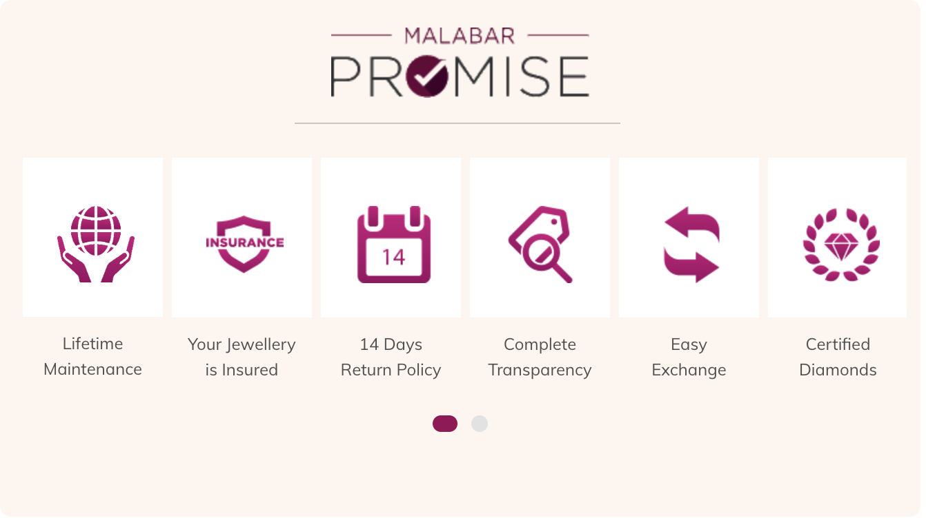
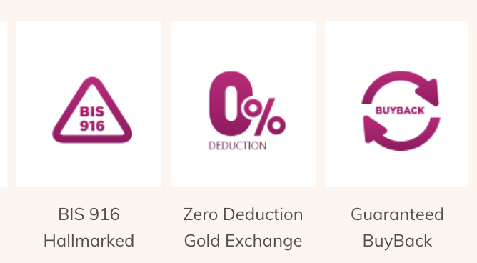
Company Overview
 | Ahammed M P | 18.8%
 | Shamlal M P | 10.02%
 | Abdul Salam K P | 8.01%
 | Mayankutty C | 7.11%
 | Nishad A K | 5.01%
 | Veerankutty P | 4.01%
Business Model
Opportunities
Product Portfolio
Key Management

Slide 11
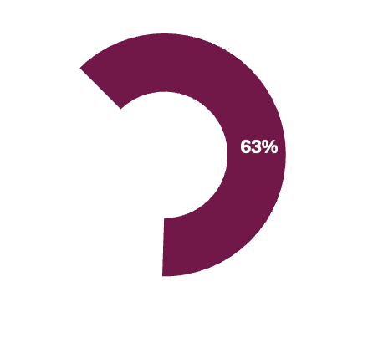
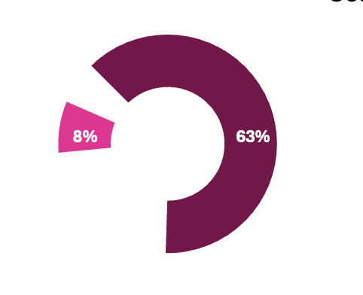
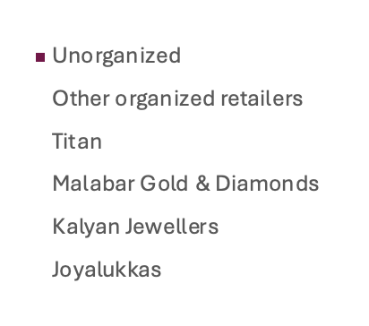

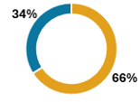
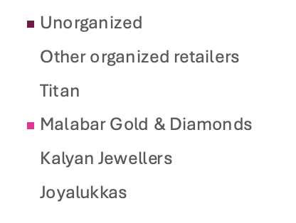


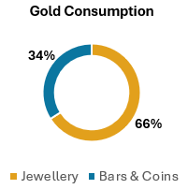
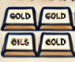
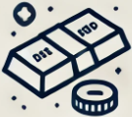



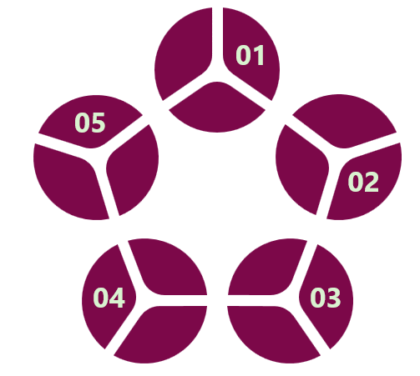

Gold & Jewellery Retail Industry Analysis
The gold and jewellery retail industry encompasses both traditional gold and non-gold segments, which include jewellery made from diamonds, silver, precious stones, platinum, and other materials.
Indian Market
27%
India’s share of global gold consumption
Gold Consumption
Market Share
Key Market Trends
Emergence of online jewellery market with an expected growth rate of 12% by FY28
Increasing preference for lightweight jewellery driven by working women and young population
BIS hallmark certification for quality assurance boosting consumer trust in the jewellery retailers
Gold as an investment option, with gold bars and coins comprising 34% of gold consumption in FY23
Buyback schemes and Monthly Investment Plans (MIPs) to promote consumer loyalty
Expansion of male jewellery market
Rising influence of social media in shaping fashion trends and visibility
US$ 70B
Market size (2023)
16% CAGR
Exp. growth (2023-2028)
Organized Retail Jewellers – Sourcing & Procurement Framework
Gold & Diamond Import
Gold & Diamond Procurement by Retailers
Hedging Strategy by Gold Retailers
Jewellery Procurement
Growth Drivers
Key Opportunities and Threats
1
Increasing disposable income leading to consumer spending on premium products
Expansion of retail stores into Tier II /III cities
Cultural and social significance of gold during weddings and festivals
India’s growing working age population
Global advantage through skilled artisans
Diversification into other jewellery types like pearls and lab grown diamonds
New business models to capture the growing demand for premium and personalized opportunities
Adoption to digital channels to expand into new markets
Regional and international expansion of existing brands
2
Opportunities
Porter Five Forces Analysis
3
Rivalry: Medium
Highly fragmented
Supplier Power: Medium
Product differentiation
Backward integration
4
Demand for gold/jewellery is price sensitive
Cash flow risks due to high inventory and seasonal sales
Impact of unanticipated regulatory changes (e.g., import duty)
Buyer Power: Medium
Quality assurance
Low-cost switching
5
Threats
New Entrants: High
Opportunities in fashion and costume jewellery
6
Threat of Substitutes: High
Cheap alternatives (gifts)
Sources: Marketline, PNG DRHP, Screener.com, Private Circle – Joyalukkas
Notes:
This is a 70B $ market growing at 16% CAGR.
While there is consistent demand from wedding and festival seasons, there are growth opportunities fueled by rising disposable incomes, middle-class aspirations, and the retail push into Tier II and III cities
The jewellery market is also transforming through the rise of online platforms, lightweight designs for modern consumers, BIS hallmarking creating new business models and opportunities for expansion.
It is worthwhile to note that this industry has high costs primarily driven by procuremen– Gold and Diamonds and is subjected to unanticipated regulatory changes.
Having said that, this market is highly unorganized, with 63% dominated by informal players and Malabar holds an 8% market share. As the consumers are increasingly shifting away from family jewellers, there is a huge headroom for organized players like Malabar in this industry.

Slide 12
Peer Benchmarking
Comprehensive analysis of the company’s geographical footprint, revenue models, financial health, and value chain integration, offering insights into its market positioning, operational efficiency, and strategic priorities.
All figures are in INR Cr
Parameters | Malabar Gold & Diamonds | Titan Company* | Kalyan Jewellers | Senco Gold | P N Gadgil Jewellers | Rajesh Exports | PC Jewellers | Thangamayil | Joyalukkas** | Sky Gold | T B Z | Radhika Jeweltec | Asian Star Co.
Parameter
Key Insights (Malabar Gold & Diamonds Vs Peers)
Malabar is among the top revenue generators, indicating robust market demand
Sales (Cr) | 40k-50k | 50k-60k | 10k-20k | 1k-10k | 1k-10k | >60k | <1k | 1k-10k | 10k-20k | 1k-10k | 1k-10k | <1k | 1k-10k
D/E | 0.93 | 1.65 | 1.07 | 1.28 | 0.66 | 1.17 | 0.04 | 1.08 | 0.50 | 1.3 | 1.02 | 0.19 | 0.49
Lower debt(0.93) compared to major competitors reflects good financial health and growth flexibility
Stores (South India) | 67% | 37% | 55% | 2% | 0% | 100% | 0% | 100% | 66% | 80% | 3% | 0% | 0%
Strong regional expertise and brand recognition in South India, competing with Kalyan & Joyalukkas
Stores (India) | 205 | 750 | 209 | 145 | 27 | 82 | 79 | 59 | 105 | 10 | 34 | 2 | 0
Broad national footprint, behind Titan (750) indicating extensive operational scale and strong reach
International Stores | 145 | 25 | 30 | 1 | 1 | 0 | 0 | 0 | 55 | 0 | 0 | 0 | 0
Market leader internationally, far ahead of Joyalukkas (55), capturing global demand effectively
Revenue streams | B2C Offline + E-comm | B2C Offline + E-comm | B2C Offline + E-comm | B2C Offline + E-comm | B2C Offline + E-comm | B2C Offline + E-comm | B2C Offline + E-comm | B2C Offline + E-comm | B2C Offline + E-comm | Majorly B2B | B2C Offline + E-comm | B2C Offline | B2B
Matches Titan and Kalyan’s omnichannel strategy, ensuring adaptability to evolving consumer trends
Integration | Retail + Manufacture | Retail + Manufacture | Retail + Manufacture | Retail + Manufacture | Retail | Majority Manufacture | Retail + Manufacture | Retail + Manufacture | Retail + Manufacture | Majority Manufacture | Retail + Manufacture | Retail + Manufacture | Manufacture
Vertical integration is similar to companies like Kalyan and Titan, ensuring cost efficiency and value control
Key competitors
These competitors closely align with Malabar’s business model, positioning, and strategies across revenue, footprint, and operations.
Key Competitors
(Focus Group)
* Titan Company includes various segments such as watches, jewellery, Indian wear, fragrance and fashion accessories, however, as financial and operational metrics specific to jewellery segment are not publicly available, metrics for the Titan Company as a whole have been considered.
** Estimates for FY2022-23 have been used as estimates for FY2023-24 were not available
Sources: Screener.com Private Circle - Joyalukkas
Company website and annual reports
Notes:
These are the leading players in the Gold & Jewellery Retail market. We will further narrow these down based on these parameters like Sales. These parameters are chosen to understand the size, geographical footprint and revenue models of the firms.
We have highlighted the values that are comparable to Malabar for this parameter.
The companies similar to MGD in size are higlighted and so on and so forth for each parameter.
D/E tells us about the stage of financing.
To gauge the distribution of presence, we have counted South Indian, PAN Indian and –international presence.
Vertical Integration
Based on how close these companies resemble MGD, we have chosen the focused core group

Slide 13
Peer Benchmarking
Comprehensive analysis of the company’s geographical footprint, revenue models, financial health, and value chain integration, offering insights into its market positioning, operational efficiency, and strategic priorities.
All figures are in INR Cr
Parameter
Key Insights (Malabar Gold & Diamonds Vs Peers)
Malabar is among the top revenue generators, indicating robust market demand
Lower debt(0.93) compared to major competitors reflects good financial health and growth flexibility
Strong regional expertise and brand recognition in South India and competing with Kalyan and Joyalukkas
Broad national footprint, behind Titan (750) indicating extensive operational scale and strong reach
Market leader internationally, far ahead of Joyalukkas (55), capturing global demand effectively
Matches Titan and Kalyan’s omnichannel strategy, ensuring adaptability to evolving consumer trends
Vertical integration is similar to companies like Kalyan and Titan, ensuring cost efficiency and value control
Parameters | Malabar Gold & Diamonds | Titan Company* | Kalyan Jewellers | Senco Gold | P N Gadgil Jewellers | Rajesh Exports | PC Jewellers | Thangamayil | Joyalukkas** | Sky Gold | T B Z | Radhika Jeweltec | Asian Star Co.
Sales (Cr) | 40k-50k | 50k-60k | 10k-20k | 1k-10k | 1k-10k | >60k | <1k | 1k-10k | 10k-20k | 1k-10k | 1k-10k | <1k | 1k-10k
D/E | 0.93 | 1.65 | 1.07 | 1.28 | 0.66 | 1.17 | 0.04 | 1.08 | 0.50 | 1.3 | 1.02 | 0.19 | 0.49
Stores (South India) | 67% | 37% | 55% | 2% | 0% | 100% | 0% | 100% | 66% | 80% | 3% | 0% | 0%
Stores (India) | 205 | 750 | 209 | 145 | 27 | 82 | 79 | 59 | 105 | 10 | 34 | 2 | 0
International Stores | 145 | 25 | 30 | 1 | 1 | 0 | 0 | 0 | 55 | 0 | 0 | 0 | 0
Revenue streams | B2C Offline + E-comm | B2C Offline + E-comm | B2C Offline + E-comm | B2C Offline + E-comm | B2C Offline + E-comm | B2C Offline + E-comm | B2C Offline + E-comm | B2C Offline + E-comm | B2C Offline + E-comm | Majorly B2B | B2C Offline + E-comm | B2C Offline | B2B
Integration | Retail + Manufacture | Retail + Manufacture | Retail + Manufacture | Retail + Manufacture | Retail | Majority Manufacture | Retail + Manufacture | Retail + Manufacture | Retail + Manufacture | Majority Manufacture | Retail + Manufacture | Retail + Manufacture | Manufacture
Key competitors
These competitors closely align with Malabar’s business model, positioning, and strategies across revenue, footprint, and operations.
Key Competitors
(Focus Group)
* Titan Company includes various segments such as watches, jewellery, Indian wear, fragrance and fashion accessories, however, as financial and operational metrics specific to jewellery segment are not publicly available, metrics for the Titan Company as a whole have been considered.
** Estimates for FY2022-23 have been used as estimates for FY2023-24 were not available
Sources: Screener.com Private Circle - Joyalukkas
Company website and annual reports

Slide 14
Key Metrics
Insights -
Malabar Gold & Diamonds
Risks to consider
Parameters | Malabar Gold & Diamonds | Titan Company | Kalyan Jewellers | Senco Gold | Thangamayil | Joyalukkas** | T B Z
P/E |  | 87 | 118 | 50 | 55 | 18.2 | 33
Revenue from Operations | 47448 | 52453 | 19708 | 5340 | 4094 | 14526 | 2324
EBITDA | 1307 | 5334 | 1164 | 405 | 198 | 1529.65 | 130
EBITDA Margin | 2.7% | 10.2% | 5.9% | 7.6% | 4.6% | 5.6% | 10.5%
PAT | 741.00 | 3454.00 | 630.29 | 213.62 | 121.19 | 899 | 60.11
PAT Margin | 0.02 | 0.07 | 0.03 | 0.04 | 0.03 | 6.20% | 0.03
ROE | 19.00% | 32.91% | 15.22% | 16.32% | 27.95% | 31.35% | 9.33%
ROCE | 22.00% | 22.70% | 14.04% | 13.82% | 20.29% | 35.60% | 10.88%
Current Ratio | 1.29 | 1.45 | 1.31 | 1.56 | 1.54 | 1.90 | 1.66
Stores (Global) | 350 | 775 | 239 | 146 | 59 | 160 | 34
Revenue from Ops. per store | 136 | 68 | 82 | 36 | 69 | 91 | 68
Revenue from Ops. per sq. feet | 0.02 | 0.02 | 0.01 | 0.01 | 0.05 | 0.02 | 0.02
EBITDA per store | 2.76 | 6.88 | 4.87 | 2.77 | 3.37 | 9.56 | 3.84
PAT per store | 2.12 | 4.46 | 2.64 | 1.46 | 2.05 | 5.62 | 1.77
Days Inventory | 28.57 | 176.34 | 191.27 | 200.95 | 127.52 | 274.45 | 159.87
Severe Risks
Not identified
Strengths
Financial
Strong revenue performance with high efficiency per store, indicating a focused and high-performing store model
Exceptional inventory turnover of 29 days indicates efficient inventory management and good operational strength
Medium Risks
Low Cash Balance
Low Risks
Low inventory
Thin Margins
Income Projections based on key metrics FY 24-25
405 Stores
139 Cr
/Store
56,241
Cr.
Weaknesses
MGD to add 100 stores by 2025 and revenue/store has been consistently growing @ 7.8% for last 3 years
Low profit margins despite high revenue, indicates high operational costs or lower pricing power highlighting the need for cost control systems
Low liquidity (current ratio of 1.29) suggests potential short-term liquidity issues and financial inflexibility
REVENUE
COSTS
Operational
12,631 Cr
23,376 Cr
1,642 Cr
Cost Materials Consumed
Purchase of stock traded + Operating Expenses
EBITDA
Opportunities
This is observed to proportional w.r.t to revenue.
22-27% revenues.
This is highly driven by purchase of gold and diamond. Hence directly proportional to revenue
(40-45% of revenues)
Very thin margin of
2-5%
Malabar is effectively using its capital (ROCE of 22%), but the return to shareholders could be improved, possibly through better profit management
All figures are in INR Cr
** Estimates for FY2022-23 have been used as estimates for FY2023-24 were not available
Sources: Screener.com Moneycontrol Private Circle - Joyalukkas

Slide 15
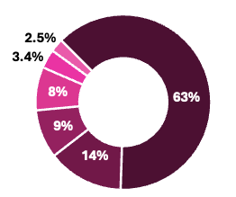
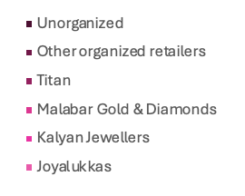
Gold & Jewellery Retail Industry Analysis
The gold and jewellery retail industry encompasses both traditional gold and non-gold segments, which include jewellery made from diamonds, silver, precious stones, platinum, and other materials.
Indian Market
27%
India’s share of global gold consumption
Gold Consumption
Market Share
Key Market Trends
Emergence of online jewellery market with an expected growth rate of 12% by FY28
Increasing preference for lightweight jewellery driven by working women and young population
BIS hallmark certification for quality assurance boosting consumer trust in the jewellery retailers
Gold as an investment option, with gold bars and coins comprising 34% of gold consumption in FY23
Buyback schemes and Monthly Investment Plans (MIPs) to promote consumer loyalty
Expansion of male jewellery market
Rising influence of social media in shaping fashion trends and visibility
US$ 70B
Market size (2023)
16% CAGR
Exp. growth (2023-2028)
Organized Retail Jewellers – Sourcing & Procurement Framework
Gold & Diamond Import
Gold & Diamond Procurement by Retailers
Hedging Strategy by Gold Retailers
Jewellery Procurement
Growth Drivers
Key Opportunities and Threats
1
Increasing disposable income leading to consumer spending on premium products
Expansion of retail stores into Tier II /III cities
Cultural and social significance of gold during weddings and festivals
India’s growing working age population
Global advantage through skilled artisans
Diversification into other jewellery types like pearls and lab grown diamonds
New business models to capture the growing demand for premium and personalized opportunities
Adoption to digital channels to expand into new markets
Regional and international expansion of existing brands
2
Opportunities
Porter Five Forces Analysis
3
Rivalry: Medium
Highly fragmented
Supplier Power: Medium
Product differentiation
Backward integration
4
Demand for gold/jewellery is price sensitive
Cash flow risks due to high inventory and seasonal sales
Impact of unanticipated regulatory changes (e.g., import duty)
Buyer Power: Medium
Quality assurance
Low-cost switching
5
Threats
New Entrants: High
Opportunities in fashion and costume jewellery
6
Threat of Substitutes: High
Cheap alternatives (gifts)
Sources: Marketline, PNG DRHP, Screener.com, Private Circle – Joyalukkas
Notes:
This is a 70B $ market growing at 16% CAGR.
While there is consistent demand from wedding and festival seasons, there are growth opportunities fueled by rising disposable incomes, middle-class aspirations, and the retail push into Tier II and III cities
The jewellery market is also transforming through the rise of online platforms, lightweight designs for modern consumers, BIS hallmarking creating new business models and opportunities for expansion.
It is worthwhile to note that this industry has high costs primarily driven by procuremen– Gold and Diamonds and is subjected to unanticipated regulatory changes.
Having said that, this market is highly unorganized, with 63% dominated by informal players and Malabar holds an 8% market share. As the consumers are increasingly shifting away from family jewellers, there is a huge headroom for organized players like Malabar in this industry.

Slide 16
Key Metrics
Parameters | Malabar Gold & Diamonds | Titan Company | Kalyan Jewellers | Senco Gold | Thangamayil | Joyalukkas** | T B Z
Financial
P/E |  | 87 | 118 | 50 | 55 | 18.2 | 33
Revenue from Operations | 47,448 | 52,453 | 19,708 | 5,340 | 4,094 | 14,526 | 2,324
EBITDA | 1,307 | 5,334 | 1,164 | 405 | 198 | 1,529.65 | 130
EBITDA Margin | 2.7% | 10.2% | 5.9% | 7.6% | 4.6% | 5.6% | 10.5%
PAT | 741.00 | 3454.00 | 630.29 | 213.62 | 121.19 | 899 | 60.11
PAT Margin | 0.02 | 0.07 | 0.03 | 0.04 | 0.03 | 6.20% | 0.03
ROE | 19.00% | 32.91% | 15.22% | 16.32% | 27.95% | 31.35% | 9.33%
ROCE | 22.00% | 22.70% | 14.04% | 13.82% | 20.29% | 35.60% | 10.88%
Current Ratio | 1.29 | 1.45 | 1.31 | 1.56 | 1.54 | 1.90 | 1.66
47,448
2.7%
19.00%
Operational
Stores (Global) | 350 | 775 | 239 | 146 | 59 | 160 | 34
Revenue from Ops. per store | 136 | 68 | 82 | 36 | 69 | 91 | 68
Revenue from Ops. per sq. feet | 0.02 | 0.02 | 0.01 | 0.01 | 0.05 | 0.02 | 0.02
EBITDA per store | 2.76 | 6.88 | 4.87 | 2.77 | 3.37 | 9.56 | 3.84
PAT per store | 2.12 | 4.46 | 2.64 | 1.46 | 2.05 | 5.62 | 1.77
Days Inventory | 28.57 | 176.34 | 191.27 | 200.95 | 127.52 | 274.45 | 159.87
136
0.02
2.76
2.12
All figures are in INR Cr
** Estimates for FY2022-23 have been used as estimates for FY2023-24 were not available
Sources: Screener.com Moneycontrol Private Circle - Joyalukkas
Notes:
Let’s delve deeper into key financial and operational metrics.
Although, revenue has grown over 20% , EBIDTA margins have taken a dip. Despite having highest revenue per store, suffers from lowest EBITDA margin. One reason is lack of cost efficiency. Malabar owns only 27% of manufacturing and designing capabilities, leading to high making costs. The company plans to expand the same by 5-10% within next two years giving an upside EBITDA potential of 2-3% in long term. Moreover, Titan, which has a high EBIDTA margin owns different business unit and product lines that has higher margins.

Slide 17
Company Overview
1993 Established
360+
outlets
13
countries
14
Manufacturing units, India and GCC
12
Jewellery brands
$6.2 bn
Annual Turnover
manufacturing, selling, franchising and trading in gold jewellery, diamond studded jewellery and silver items and operates in different geographical areas
308,924
234,454
Revenue from operations
Things to cover
Stores breakup
Shareholding pattern
Exports
List of Key Rating Drivers
Strengths
• Strong revenue growth; retail division margins robust
• Operational synergies due to in-house jewellery manufacturing
• Continued geographical diversification
• Improvement in corporate governance and internal control systems
Weaknesses
• Complex group structure
• Overall margins low
• Moderate credit metrics
• Intense competition
• Regulatory risks
https://www.indiaratings.co.in/pressrelease/70206
2,034
2,840
1,610
Other
income
1,896
2022
2021
Business Model
The Company is primarily engaged in the business of manufacturing, sale and trading of gold jewellery, bullion, diamond studded jewellery and silver items. The Company has strong retail network through direct retail stores and franchisee arrangements.
2022
2021
Rev from operation
310,958
234,454
Products
326,740
308,924
232,844
3,218
Franchise fee
2,034
1,610
Product Portfolio
Other income
2,840
1,896
313,798
236,350
Key Management
India 458,587 371,648
ROW 15,898 14,038

Slide 18
Peer group data
https://awsone.capitaline.com/index.html#/Company/General/CompanyInfo
Complete industry analysis and peer analysis
https://advantage.marketline.com/Analysis/ViewasPDF/india-jewelry-watch-retail-ml-221233
https://www.sebi.gov.in/filings/public-issues/mar-2024/p-n-gadgil-jewellers-limited-drhp_82611.html
https://www.sebi.gov.in/filings/public-issues/mar-2021/kalyan-jewellers-india-limited-red-herring-prospectus_49470.html
https://timesofindia.indiatimes.com/malabar-gold-and-diamonds-one-india-one-gold-rate-offers-lowest-price-in-india/articleshow/91441936.cms#:~:text=The%20brand%20is%20able%20to,for%20gold%20across%20the%20country.
https://www.ventureintelligence.com/cfsnew/details.php?vcid=19463&search=MALABAR+GOLD+LIMITED
Transaction Multiple – EV/EBITDA Trading Multiple – P/E
Refinitiv / pevc

Slide 19
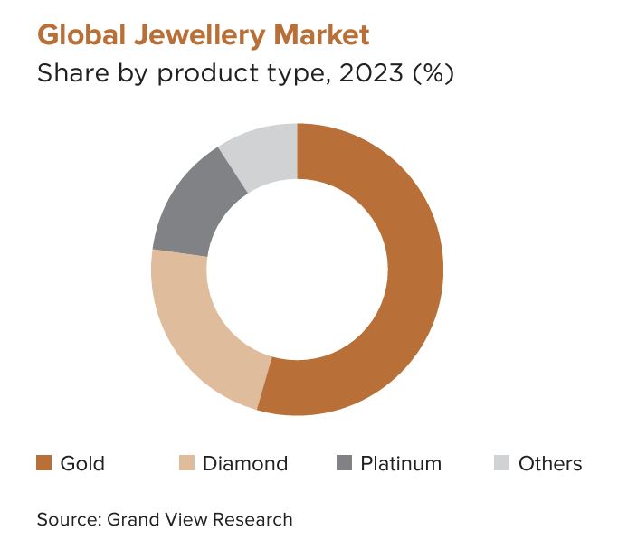
Industry Overview
With rising disposable incomes and technological advancements, the demand for both traditional and contemporary jewellery is rising.
The market also sees a growing preference for lightweight and fusion jewellery that appeals to modern tastes.
Retail sales are boosted by consumer spending during weddings and traditional occasions such as Dhanteras, Akshaya Tritiya, Baisakhi, Karva Chauth, Durga Puja, Gudi Padwa. (Source: TECHNAVIO)
Bridal jewellery is a major market driver, especially in India, where substantial spending on wedding ceremonies and celebrations positively impacts market growth.
Gold jewellery demand and ownership is higher in rural India and rises with income levels.
Bridal jewellery accounts for 50-55% of the gold jewellery market.
Gold continues to be a timeless favourite, showcasing India’s enduring appreciation for precious metals and intricate craftsmanship. (Source: Technavio)
Gold prices in India have seen significant fluctuations and increases over the past few years. In year 2022, the price of gold was ₹52,670 (24 Karat per grams), which jumped to ₹65,330 in 2023, and has further increased to ₹74,175 in 2024.
This upward trend can be attributed to various factors including the RussiaUkraine war, the US Federal Reserve’s rate increases, and inflation.
The Global jewellery market size was valued at USD 224.39 billion in 2023 and is projected to grow from USD 232.94 billion in 2024 to USD 343.90 billion by 2032, exhibiting CAGR of 4.99% during the forecast period. (Source: Fortunate Business Insight)
India’s strong affinity for gold and its deep cultural significance have created the growth of a vibrant goldbased financial market.
India has become the fifth-largest importer of gold and holds one of the world’s largest gold reserves.
The India jewellery market size was estimated at USD 85.52 billion in 2023 and is expected to grow at a CAGR of 5.7% from 2024 to 2030. In FY23 India jewellery market accounted for the share of 24.21% of the global jewellery market. Meanwhile, gold jewellery accounted for a revenue share of 77.72%. (Source: Grand View Research) The Indian gold market has experienced 6-7 % growth in the first quarter of 2024. (Source: Deccan Herald)

Slide 20
Retail Strategy: Unlike Tanishq, which focuses on value, Malabar drives volumes, primarily through gold-based products.
Global Presence: With 345 stores across 13 countries, Malabar was one of the first to master international retail, especially in the Middle East and Far East, targeting Indian diasporas.
Cost Optimization: They have 15 manufacturing units across six countries, optimizing production and gold purchase costs. Factories are strategically located in gold route hubs like Kerala, UAE, and Qatar.
https://www.youtube.com/watch?v=DopM-KIwIKI
https://www.ceo-middleeast.com/ceo/business/410604-one-for-the-textbooks-unique-company-philosophy-that-turns-employees-to-investors
https://english.dhanamonline.com/business-kerala/the-glittering-business-strategy-of-malabar-gold-and-diamonds-6805318
Company Overview

Slide 24
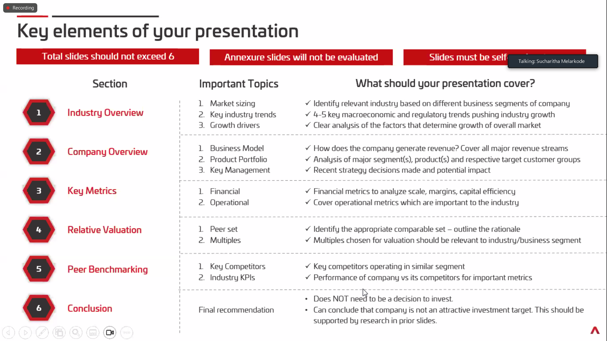

Slide 25
Gold & Jewellery Retail Industry
1. Retail Market Consumption
Strengths
Market Sizing
Strong revenue performance with high efficiency per store, indicating a focused and high-performing store model
Organized Jewellers –
Sourcing & Procurement Framework
Gold & Diamond Import
Gold & Diamond Procurement by Retailers
Hedging Strategy by Gold Retailers
Jewellery Procurement
Growth Drivers
Robust growth in exports
• The Government of India is aiming at US$ 100 billion in jewellery export in the next few years (until 2027), up from US$ 35 billion in 2020.
• In April-June 2024, India's gems and jewellery exports were at US$ 6.87 billion. In June 2024, India’s gems and jewellery exports were at US$ 1.91 billion.
Strong revenue performance with high efficiency per store (INR 136 Cr.), indicating a focused and high-performing store model
Exceptional inventory turnover of 29 days indicates efficient inventory management and good operational strength
Exceptional inventory turnover of 29 days indicates efficient inventory management and good operational strength
Sources:
https://advantage.marketline.com/Analysis/IndustryProfile/india-jewelry-watch-retail-ml-221233
2. XXX

Slide 27
Peer Benchmarking
Following benchmarking metrics are selected to provide a comprehensive analysis of the company’s geographical footprint, revenue models, financial health, and value chain integration, offering insights into its market positioning, operational efficiency, and strategic priorities.
Parameters | Malabar Gold & Diamonds | Titan Company | Kalyan Jewellers | Senco Gold | P N Gadgil Jewellers | Rajesh Exports | PC Jewellers | Thangamayil | Joyalukkas | Sky Gold | T B Z | Radhika Jeweltec | Asian Star Co.
Sales (Cr) | 40k-50k | 50k-60k | 10k-20k | 1k-10k | 1k-10k | >60k | <1k | 1k-10k |  | 1k-10k | 1k-10k | <1k | 1k-10k
D/E | 0.93 | 1.65 | 1.07 | 1.28 | 0.66 | 1.17 | 0.04 | 1.08 |  | 1.3 | 1.02 | 0.19 | 0.49
Stores (South India) | 67% | 37% | 55% | 2% | 0% | 100% | 0% | 100% | 66% | 80% | 3% | 0% | 0%
Stores (India) | 205 | 750 | 209 | 145 | 27 | 82 | 79 | 59 | 105 | 10 | 34 | 2 | 0
International Stores | 145 | 25 | 30 | 1 | 1 | 0 | 0 | 0 | 55 | 0 | 0 | 0 | 0
Revenue streams | B2C Offline + E-comm | B2C Offline + E-comm | B2C Offline + E-comm | B2C Offline + E-comm | B2C Offline + E-comm | B2C Offline + E-comm | B2C Offline + E-comm | B2C Offline + E-comm | B2C Offline + E-comm | Majorly B2B | B2C Offline + E-comm | B2C Offline | B2B
Integration | Retail + Manufacture | Retail + Manufacture | Retail + Manufacture | Retail + Manufacture | Retail | Majority Manufacture | Retail + Manufacture | Retail + Manufacture | Retail + Manufacture | Majority Manufacture | Retail + Manufacture | Retail + Manufacture | Manufacture
Key Insights
Tracks the revenue profile. Helps assess the overall financial size of the business
Helps with the Capital Structure of the company
Tells about the focus in South India and competition with MGD
Benchmarking of presence of business at National level
International presence of the chain
Helps with channels of revenue and set a comparative benchmarking
Company Presence in Value Chain
Key competitors

Slide 28
Gold & Jewellery Retail Industry
1. Retail Market Consumption
Market Sizing
Key Market Trends
Growth Drivers
Challenges
Opportunities
Demand for Lightweight Jewellery: Younger consumers are looking for jewellery that matches Western attire
Gold as an Investment: Bars and coins, comprising ~34% of gold consumption in FY 2023, are projected to grow at 21% CAGR to meet raising investor demand
Rising Influence of Social Commerce and Digital Platforms: Influencer marketing shapes fashion trends and boosts accessory sales
Male Consumer Market Expansion: Gender inclusivity in jewelry is on the rise, with more collections designed specifically for male consumers
Increasing Disposable Income and Consumer Spending: India’s rising middle class (~42% by FY2030) drive the spending on premium products
Expansion in Tier II and III Cities: Organized retailers (~37% of jewellery market) are expanding to smaller cities capturing untapped demand
Cultural and Social Significance: Indian traditions drives demand for gold, especially during weddings and festivals
India’s Young Population: This demographic fuels demand for fashion jewellery and cross cultural designs
Price Sensitivity: Volatility in gold prices may affect demand, adding pressure on margins
Impact of Import Duties: In FY 2023, India’s gold demand declined due to the increase in import duty from 7.5% to 12.5%, which increased retail prices
Economic Sensitivity: Jewellery sales are closely tied to economic growth and discretionary spending, making the industry vulnerable to slowdowns and inflation
New Business Models: Increasing disposable income offers opportunities to create premium and personalized jewellery offerings
E-commerce and social media: Adoption of digital channels can help engage local artisans and expand into new markets
Regional and international expansion: Regional players can scale nationwide, and Indian brands can explore international markets
Sources:
https://advantage.marketline.com/Analysis/IndustryProfile/india-jewelry-watch-retail-ml-221233
2. XXX

Slide 29
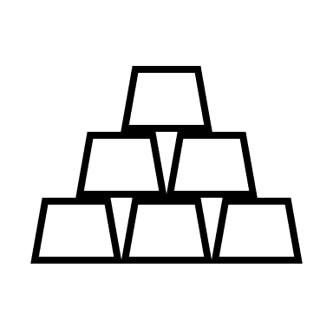
Key Metrics
Risks to consider
Parameters | Malabar Gold & Diamonds | Titan Company | Kalyan Jewellers | Senco Gold | Thangamayil | Joyalukkas | T B Z | Key Insights (Malabar Gold & Diamonds Vs Peers)
P/E |  | 87 | 118 | 50 | 55 | 18.2 | 33
Revenue from Operations | 47448 | 52453 | 19708 | 5340 | 4094 | 14526 | 2324
EBITDA | 1307 | 5334 | 1164 | 405 | 198 | 1529.65 | 130
EBITDA Margin | 2.7% | 10.2% | 5.9% | 7.6% | 4.6% | 5.6% | 10.5%
PAT | 741.00 | 3454.00 | 630.29 | 213.62 | 121.19 | 899 | 60.11
PAT Margin | 0.02 | 0.07 | 0.03 | 0.04 | 0.03 | 6.20% | 0.03
ROE | 19.00 | 32.91 | 15.22 | 16.32 | 27.95 | 31.35 | 9.33
ROCE | 22.00 | 22.70 | 14.04 | 13.82 | 20.29 | 35.60 | 10.88
Current Ratio | 1.29 | 1.45 | 1.31 | 1.56 | 1.54 | 1.90 | 1.66
Stores (Global) | 350 | 775 | 239 | 146 | 59 | 160 | 34
Revenue from Ops. per store | 136 | 68 | 82 | 36 | 69 | 91 | 68
Revenue from Ops. per sq. feet | 0.02 | 0.02 | 0.01 | 0.01 | 0.05 | 0.02 | 0.02
EBITDA per store | 2.76 | 6.88 | 4.87 | 2.77 | 3.37 | 9.56 | 3.84
PAT per store | 2.12 | 4.46 | 2.64 | 1.46 | 2.05 | 5.62 | 1.77
Days Inventory | 28.57 | 176.34 | 191.27 | 200.95 | 127.52 | 274.45 | 159.87
Severe Margins
Not identified
Medium Risks
Low Cash Balance
Financial
Low Risks
Low inventory
Thin Margins
Income Projections based on key metrics FY 24-25
405 Stores
139 Cr
/Store
56,241
Cr.
MGD to add 100 stores by 2025 and revenue/store has been consistently growing @ 10% for last 3 years
REVENUE
COSTS
Operational
12,631 Cr
23,376 Cr
1,642 Cr
Cost Materials Consumed
Purchase of stock traded + Operating Expenses
EBITDA
This is observed to proportional w.r.t to revenue.
22-27% revenues.
This is highly driven by purchase of gold and diamond. Hence directly proportional to revenue
(40-45% of revenues)
Very thin margin of
2-5%
* All figures are in Cr

